Slide 1
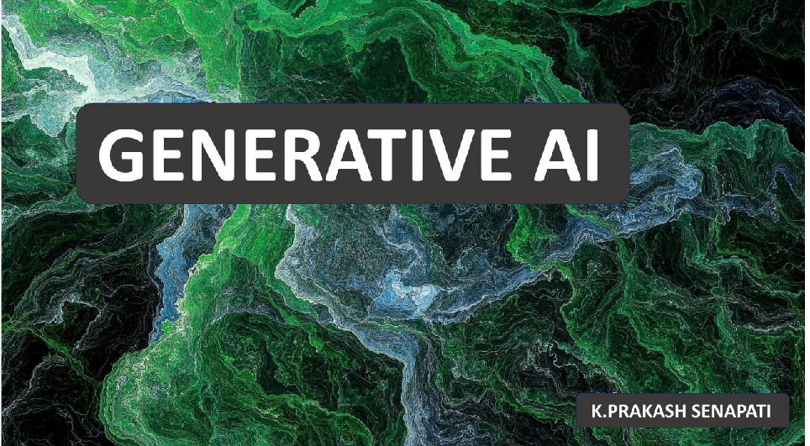
Dt: 21st- Jan 2024
Time @ 10AM (Sunday)
Duration – 2 HR

Slide 2

3- GENERATIVE ARTIFICIAL INTELLIGENCE
WHAT IS GENERATIVE AI ?
WHY GENERATIVE AI IS MORE POPULAR NOW ?
HOW GENARATIVE AI WORK ?
WHAT IS GENERATIVE AI MODELS ?
WHAT ARE DALL-E, CHATGPT & BARD ?
WHAT ARE THE USE CASES OF GENERATIVE AI , BY INDUSTRY ?
WHAT ARE THE BENEFITS OF GENERATIVE AI ?
WHAT DOES IT TAKE TO BUILD GENEARATIVE AI MODEL ?

Slide 3
WHY GENERATIVE AI IS MORE POPULAR NOW ?
Generative AI has seen significant advancements in recent times.
You’ve probably already used ChatGPT, one of the major players in the field and the fastest AI product to obtain 100 million users.
Several other dominant and emerging AI tools have people talking: DALL-E, Bard, Jasper, and more.
Major tech companies are in a race against startups to harness the power of AI applications, whether it’s rewriting the rules of search, reaching significant market caps, or innovating in other areas.

Slide 4
HOW GENEARATIVE AI WORK?
Just like a painter might create a new painting or a musician might write a new song, generative AI creates new things based on patterns it has learned.
Think about how you might learn to draw a cat. You might start by looking at a lot of pictures of cats.
Over time, you start to understand what makes a cat a cat: the shape of the body, the pointy ears, the whiskers, and so on.
Then, when you’re asked to draw a cat from memory, you use these patterns you’ve learned to create a new picture of a cat.
It won’t be a perfect copy of any one cat you’ve seen, but a new creation based on the general idea of “cat”. Generative AI works similarly.
It starts by learning from a lot of examples. These could be images, text, music, or other data.
The AI analyzes these examples and learns about the patterns and structures that appear in them.
Once it has learned enough, it can start to generate new examples that are similar to what it has seen before.
For instance, a generative AI model trained on lots of images of cats could generate a new image that looks like a cat.
In context of text a model trained on lots of text descriptions could write a new paragraph about a cat that sounds like a human wrote it. The generated content isn’t exact copies of what the AI has seen before but new pieces that fit the patterns it has learned.
The important point to understand is that the AI is not just copying what it has seen before but creating something new based on the patterns it has learned. That’s why it’s called “generative” AI.

Slide 5
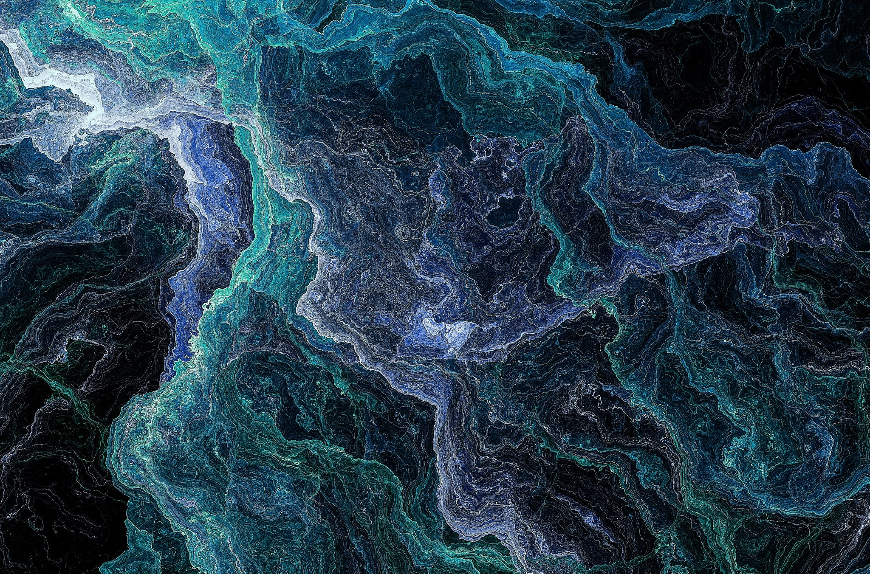
Generative AI works with 2 key features –
GAN (Generative Adversarial Network) & VAE(Various Autoencoders)
GANs, or Generative Adversarial Networks, are a class of machine learning models.
GANs are widely used for generative tasks, such as image synthesis, style transfer, and data augmentation.
The key idea behind GANs is to have two neural networks, a generator, and a discriminator, that are trained together through adversarial training. Here's an overview of how GANs work:
Generator (G):
  The generator takes random noise as input and generates samples that ideally resemble the data in the training set. It tries to create realistic data.
Discriminator (D):
  The discriminator is a separate neural network that evaluates whether a given input is real (from the training data) or fake (generated by the generator). It acts like a binary classifier.
Adversarial Training:
  The generator and discriminator are trained simultaneously in a competitive manner. The generator aims to produce data that is indistinguishable from real data, while the discriminator aims to correctly classify whether an input is real or generated.
Training Process:
  During training, the generator improves its ability to generate realistic data by receiving feedback from the discriminator. Simultaneously, the discriminator improves its ability to distinguish between real and generated data.
  GANs have been successful in generating high-quality images, creating art, and even producing deepfake videos. They are versatile and can be adapted for various generative tasks, but training GANs can be challenging and requires careful tuning of hyperparameters.

Slide 6
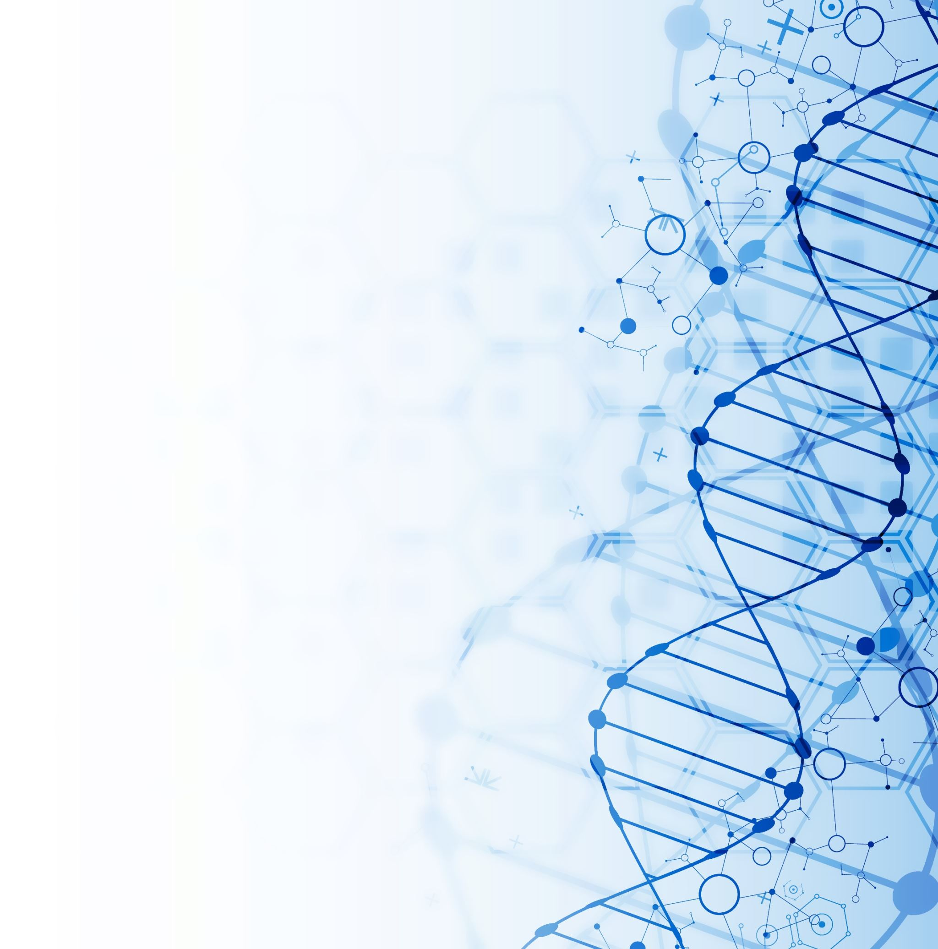
AUTOENCODERS
An autoencoder is a type of artificial neural network used for unsupervised learning. It is designed to encode the input data into a lower-dimensional representation and then decode it back to the original data. The primary objective is to learn an efficient and compressed representation of the input data.
The basic structure of an autoencoder consists of two main components:
Encoder:
  The encoder maps the input data into a lower-dimensional representation, often referred to as the "encoding" or "latent space." This process involves reducing the dimensionality of the input data, capturing its essential features.
Decoder:
  The decoder takes the encoded representation and reconstructs the original input data from it. The decoder's goal is to generate an output that closely matches the input.
The training process of an autoencoder involves minimizing the difference between the input data and the reconstructed output. This is typically done by using a loss function that measures the reconstruction error, such as mean squared error (MSE) for continuous data or binary cross-entropy for binary data.
The autoencoder's hidden layer (the encoded representation) serves as a compressed and abstract representation of the input data. This encoding can be used for various purposes, including data compression, feature learning, denoising, and anomaly detection.

Slide 7
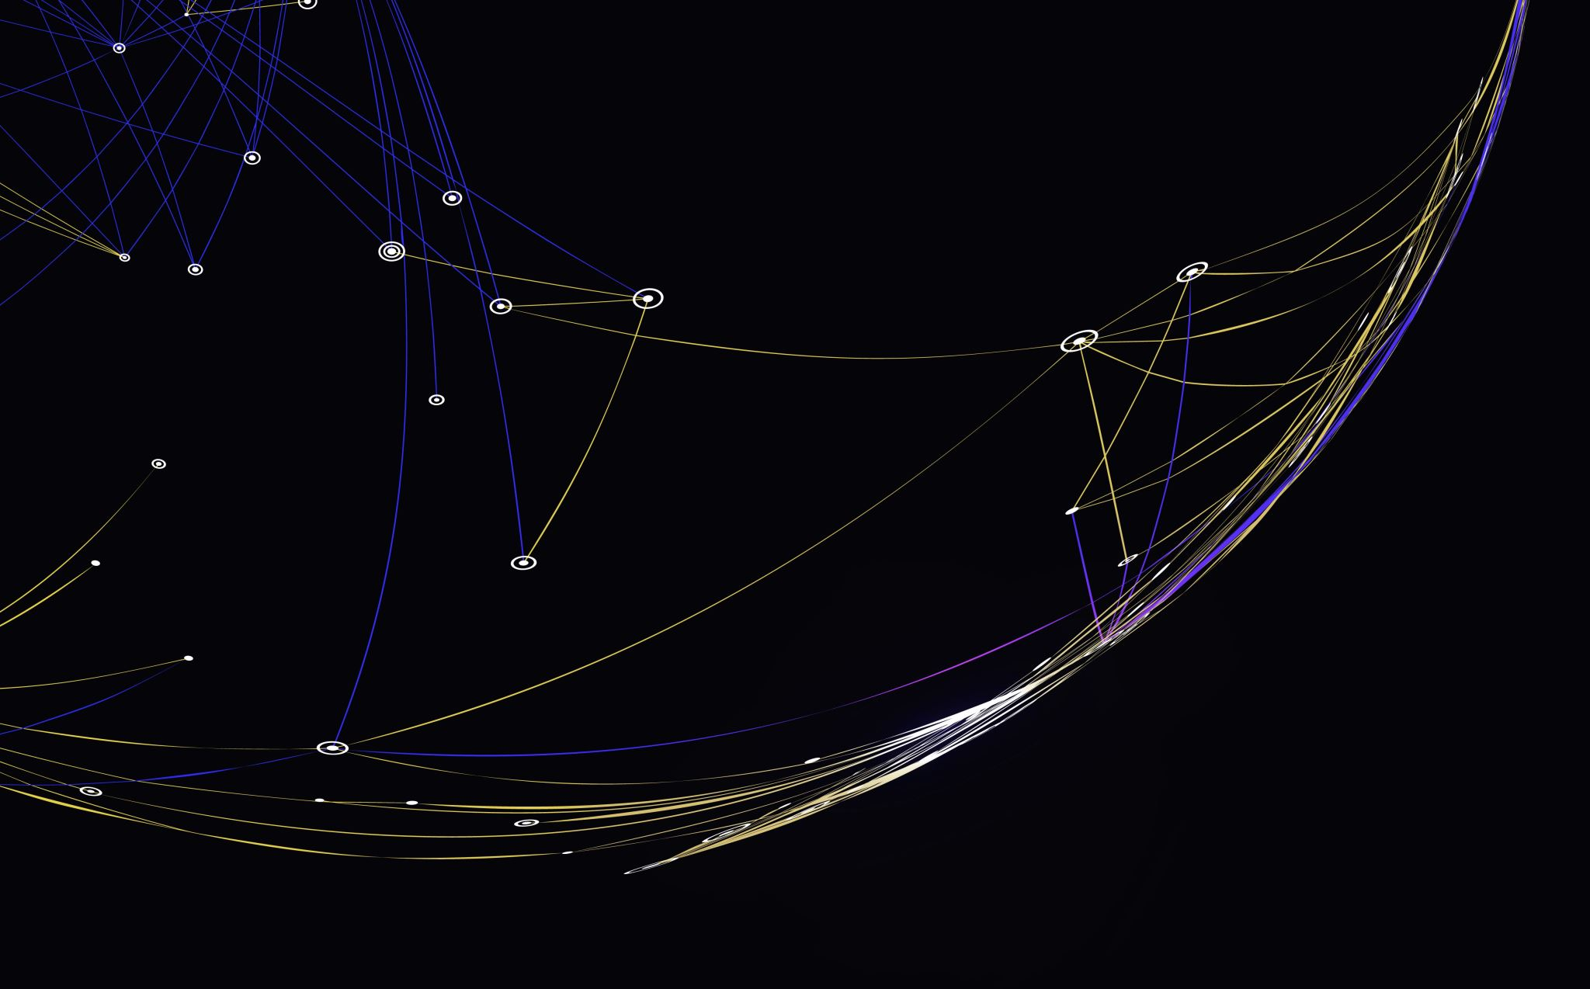
SEVERAL TYPES OF AUTOENCODERS
Vanilla Autoencoder:
  The basic form of an autoencoder consists of an encoder and a decoder. It aims to learn a compressed representation of the input data.
Variational Autoencoder (VAE):
  Introduces a probabilistic approach to encoding data, generating a latent space with a meaningful structure. It is often used for generating new data points.
Sparse Autoencoder:
  Enforces sparsity in the learned representation, meaning that only a small number of neurons in the hidden layer are activated for any given input.
Denoising Autoencoder:
  Trains the model to reconstruct the original data from a corrupted or noisy version of the input, helping it learn more robust representations.
Contractive Autoencoder:
  Adds a penalty term to the loss function that discourages the encoding from being sensitive to small variations in the input data.
Stacked Autoencoder:
  Comprises multiple layers of autoencoders, creating a deep architecture. It can be used for learning hierarchical representations.
Convolutional Autoencoder:
  Utilizes convolutional layers in both the encoder and decoder, making it suitable for image-related tasks.
Recurrent Autoencoder:
  Applies recurrent neural networks in the encoder and decoder, making it suitable for sequential data like time series or text.
Adversarial Autoencoder (AAE):
  Combines the principles of autoencoders and GANs. It includes a generator and a discriminator to improve the quality of the generated samples.
Conditional Variational Autoencoder (CVAE):
  Extends VAEs to handle conditional generation, allowing the generation of samples conditioned on specific input conditions.
The choice of the autoencoder depends on the characteristics of the data and the goals of the specific application.

Slide 8
GENERATIVE AI MODELS
For the generative AI tools that many people commonly use today, there are two main models: text-based and multimodal.
Text Models
A generative AI text model is a type of AI model that is capable of generating new text based on the data it’s trained on. These models learn patterns and structures from large amounts of text data and then generate new, original text that follows these learned patterns.
The exact way these models generate text can vary. Some models may use statistical methods to predict the likelihood of a particular word following a given sequence of words. Others, particularly those based on deep learning techniques, may use more complex processes that consider the context of a sentence or paragraph, semantic meaning, and even stylistic elements.
Generative AI text models are used in various applications, including chatbots, automatic text completion, text translation, creative writing, and more. Their goal is often to produce text that is indistinguishable from that written by a human.
Multimodal Models
A generative AI multimodal model is a type of AI model that can handle and generate multiple types of data, such as text, images, audio, and more. The term “multimodal” refers to the ability of these models to understand and generate different types of data (or modalities) together.
Multimodal models are designed to capture the correlations between different modes of data. For example, in a dataset that includes images and corresponding descriptions, a multimodal model could learn the relationship between the visual content and its textual description.
One use of multimodal models is in generating text descriptions for images (also known as image captioning). They can also be used to generate images from text descriptions (text-to-image synthesis). Other applications include speech-to-text and text-to-speech transformations, where the model generates audio from text and vice versa.

Slide 9
WHAT ARE DALL-E, CHATGPT & BARD ?
DALL-E, ChatGPT, and Bard are three of the most common, most-used, and most powerful generative AI tools available to the general public.
ChatGPT
ChatGPT is a language model developed by OpenAI. It is based on the GPT (Generative Pre-trained Transformer) architecture, one of the most advanced transformers available today. ChatGPT is designed to engage in conversational interactions with users, providing human-like responses to various prompts and questions. OpenAI’s first public release was GPT-3. Nowadays, GPT-3.5 and GPT-4 are available to some users. ChatGPT was originally only accessible via an API but now can be used in a web browser or mobile app, making it one of the most accessible and popular generative AI tools today.
DALL-E
DALL-E is an AI model designed to generate original images from textual descriptions. Unlike traditional image generation models that manipulate existing images, DALL-E creates images entirely from scratch based on textual prompts. The model is trained on a massive dataset of text-image pairs, using a combination of unsupervised and supervised learning techniques.
Bard
Bard is Google’s entry into the AI chatbot market. Google was an early pioneer in AI language processing, offering open-source research for others to build upon. Bard is built on Google’s most advanced LLM, PaLM2, which allows it to quickly generate multimodal content, including real-time images.

Slide 10

USE CASES OF GENERATIVE AI,BY INDUSTRY
Generative AI can be applied in various use cases to generate virtually any kind of content. The technology is becoming more accessible to users of all kinds thanks to cutting-edge breakthroughs like GPT that can be tuned for different applications. Some of the use cases for generative AI include the following:
Implementing chatbots for customer service and technical support.
Deploying deepfakes for mimicking people or even specific individuals.
Improving dubbing for movies and educational content in different languages.
Writing email responses, dating profiles, resumes and term papers.
Creating photorealistic art in a particular style.
Improving product demonstration videos.
Suggesting new drug compounds to test.
Designing physical products and buildings.
Optimizing new chip designs.
Writing music in a specific style or tone.

Slide 11
WHAT ARE THE BENEFITS OF GENERATIVE AI?
Generative AI can be applied extensively across many areas of the business. It can make it easier to interpret and understand existing content and automatically create new content. Developers are exploring ways that generative AI can improve existing workflows, with an eye to adapting workflows entirely to take advantage of the technology. Some of the potential.
Benefits of implementing generative AI include the following:
Automating the manual process of writing content.
Reducing the effort of responding to emails.
Improving the response to specific technical queries.
Creating realistic representations of people.
Summarizing complex information into a coherent narrative.
Simplifying the process of creating content in a particular style.

Slide 12
What Does it Take to Build a Generative AI Model?
Building a generative AI model requires the following:
Data: Generative models are trained on large amounts of data. For instance, a text-generating model might be trained on millions of books, articles, and websites. The quality and diversity of this training data can greatly affect the performance of the model.
Computation resources. Training generative models typically require significant computational power. This often involves using high-performance GPUs that can handle the intense computational demands of training large neural networks.
Model architecture. Designing the architecture of the model is a crucial step. This involves choosing the type of neural network (e.g., recurrent neural networks, convolutional neural networks, transformer networks, etc.) and configuring its structure (e.g., the number of layers, the number of nodes in each layer, etc.).
A training algorithm. The model needs to be trained using a suitable algorithm. In the case of Generative Adversarial Networks (GANs), for example, this involves a process where two neural networks are trained in tandem: a “generator” network that tries to create realistic data, and a “discriminator” network that tries to distinguish the generated data from real data.
Building a generative AI model can be a complex and resource-intensive process, often requiring a team of skilled data scientists and engineers. Luckily, many tools and resources are available to make this process more accessible, including open-source research on generative AI models that have already been built.

Slide 13
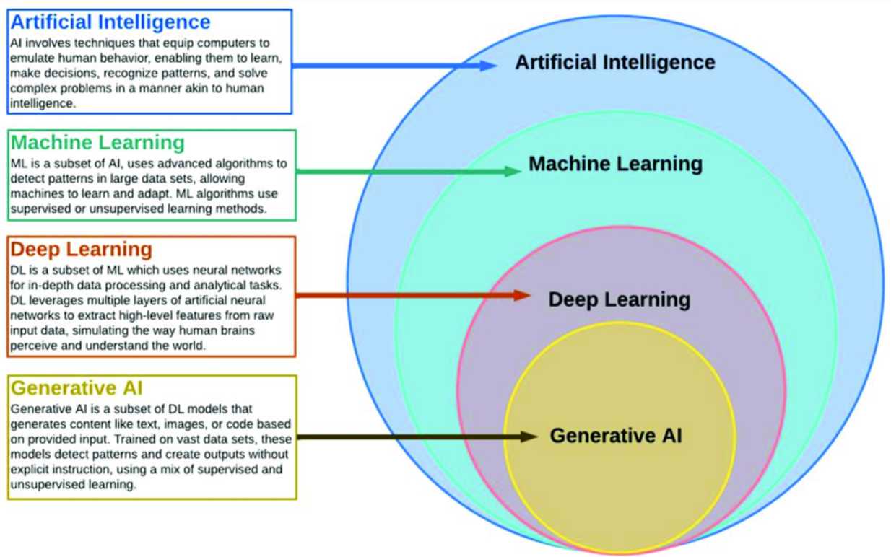
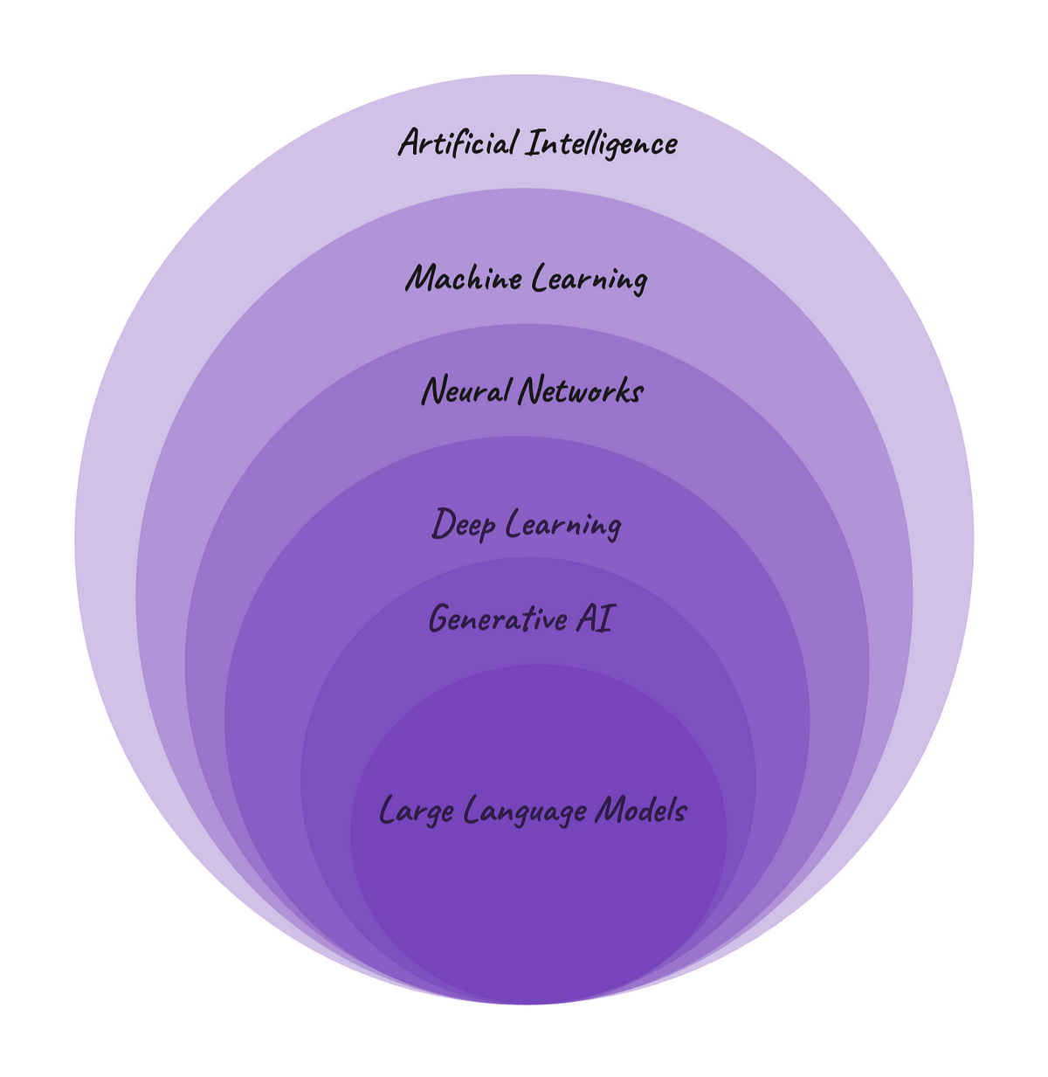
4- ARTIFICIAL INTELLIGENCE vs MACHINE LEARNING vs DEEP LEARNING VS GENERATIVE AI

Slide 14
AI vs GENERATIVE AI vs MACHINE LEARNING vs LLMS vs DEEP LEARNING vs NEURAL NETWORKS
AI refers to the broader field of computer sciences pursuing the creation of intelligent machines that can perform tasks that would be typically performed by a human. AI can perform tasks like speech recognition, problem-solving, perception, and language understanding. It can also be designed to do more specific tasks, like diagnosing medical conditions or playing chess. There are a wide range of techniques used in AI, and this includes machine learning, natural language processing, and expert systems, for example. AI can analyze data and intelligently respond to what it sees, but it is limited to this function.
Generative AI, on the other hand, takes it a step further by using data to create content that’s entirely new and in various formats. Using machine learning models, generative AI produces original content based on patterns learned from existing data. Both the fields of AI and generative AI continue to evolve and advance. Now, let’s go over some other terms you’ve likely seen floating around in relation to generative AI.
Machine learning is a subfield or method used in AI research. It involves the development of algorithms and models to enable computer systems to learn from data and make predictions or decisions. Machine learning systems learn from examples and adjust based on the data they’re exposed to, allowing it to improve its performance over time without being programmed to do so.
Large language models (LLMs) are the newest and least clearly-defined concept. A large language model, like OpenAI’s GPT-3, is a type of machine learning model that's trained on a large amount of text and specializes in text generation and understanding to generate natural-sounding replies.
Deep learning is a subfield of machine learning that focuses on training neural networks to handle more complex patterns than traditional machine learning.
Neural networks are inspired by the functioning of the human brain’s interconnected neurons. They learn by being given lots of examples and are used for various tasks like pattern recognition, classification, regression, and more. They consist of interconnected units that process and transform input data into meaningful outputs. They also learn from information over time.

Slide 15
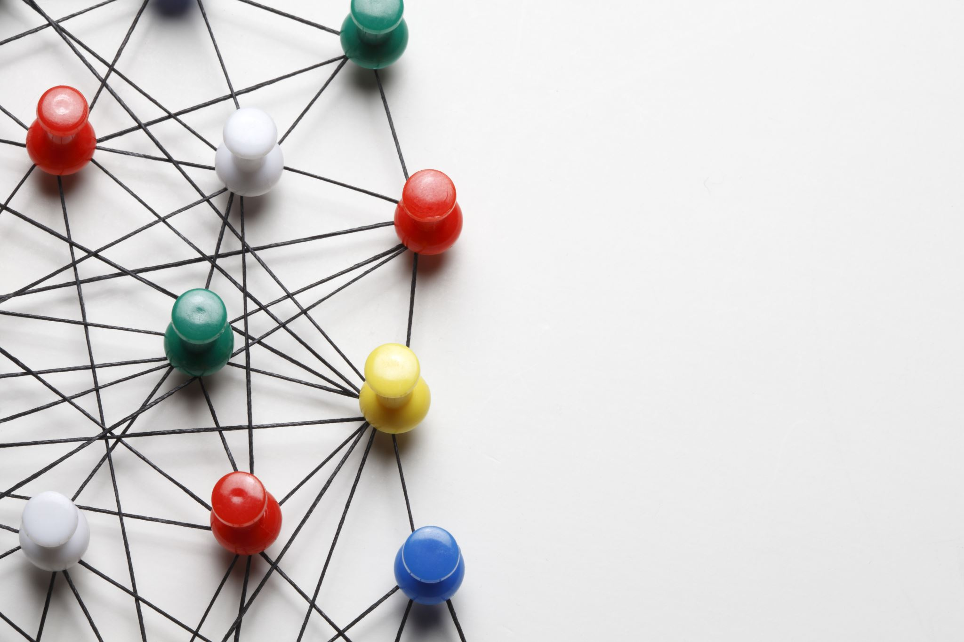
7- HOW GENERATIVE AI USED IN ORGANIZATION
Every organization trying to build the custom chatgpt for their client & customer to boost up the production
ChatGpt helps to provide the finetune answer from various resourse
In organization customer will more benefit by using the leverage of custom chatgpt, deploy in cloud through AZUR AI or many tools.
Deploying generative AI in customer service
Automate your most common FAQs with a generative approach
Elevate generative AI using analytics and insights to continually optimize automation
Precise and exhaustive titles for clear context setting
Self-contained articles
Reinvent the customer service organization
Companies are using & work on more POC or RESEARCH on Deploying Gen AI models. Largely Deploying Gen AI chatbots in their customer service strategies.

Slide 16
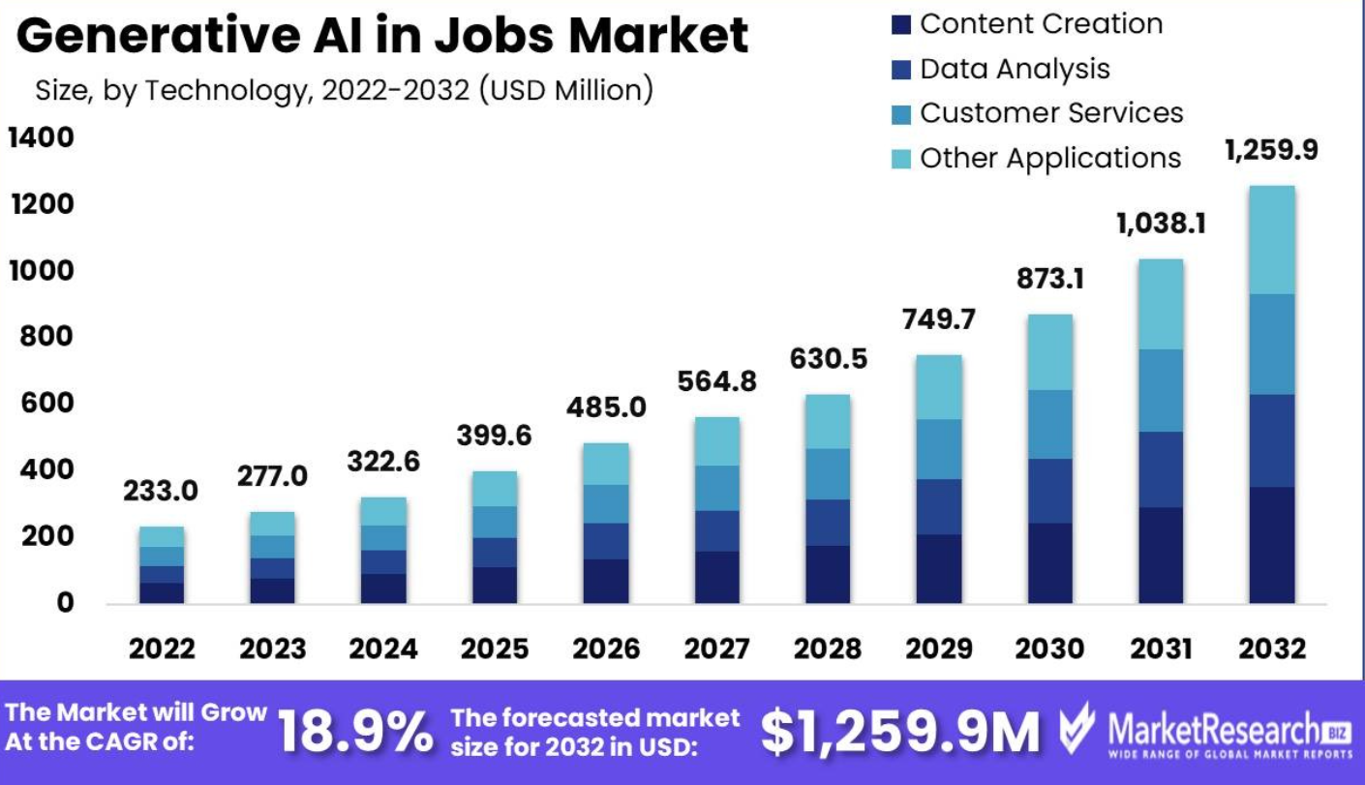
8- GENERATIVE JOB MARKET 2024- 2030 AS PER MARKET RESEARCH
Generative Ai in Jobs Market Segmentations : -
Based on Application
Content Creation
Data Analysis
Customer Services
Other Applications
Based on Technology
Natural Language Processing
Computer Vision
Machine Learning
Other Technologies
Based on Job Field
Marketing
Human Resource
Research
Other Fields

Slide 17

9-WHO ARE ELIGIBLE TO LEARN THIS COURSE
High school (10th) || College (12th) || Students can learn this for upskills in future world but not for apply the Job
College (BSC || BCOM || BA)
Engineering || B. Tech (Mechanical || Chemical || Computers || Electrical ||All Stream)
BBA || BCA || BE || Diploma || Pharma || B.ED ||
MBA || MCA || ME || M.SC || M.ED
Charted Account || Doctor
Teacher || Lecturer || Assistant Professor || Professor
Person who had career gap he is also learn this course and get the job
No Software Background is required || No Coding background is required
No mathematics background || Not required Linear algebra concept

Slide 18
11. LATEST GENERATIVE AI TECHNOLOGY
AI art (artificial intelligence art)
AI art is any form of digital art created or enhanced with AI tools.
AI prompt
An artificial intelligence (AI) prompt is a mode of interaction between a human and a LLM that lets the model generate the intended output. This interaction can be in the form of a question, text, code snippets or examples.
AI prompt engineer
An artificial intelligence (AI) prompt engineer is an expert in creating text-based prompts or cues that can be interpreted and understood by large language models and generative AI tools.
Amazon Bedrock
Amazon Bedrock -- also known as AWS Bedrock -- is a machine learning platform used to build generative artificial intelligence (AI) applications on the Amazon Web Services cloud computing platform.
Auto-GPT
Auto-GPT is an experimental, open source autonomous AI agent based on the GPT-4 language model that autonomously chains together tasks to achieve a big-picture goal set by the user.
Google Gemini
Google Gemini is a family of multimodal artificial intelligence (AI) large language models that have capabilities in language, audio, code and video understanding.
Google Search Generative Experience
Google Search Generative Experience (SGE) is a set of search and interface capabilities that integrates generative AI-powered results into Google search engine query responses.

Slide 19
Google Search Labs (GSE)
GSE is an initiative from Alphabet's Google division to provide new capabilities and experiments for Google Search in a preview format before they become publicly available.
Image-to-image translation
Image-to-image translation is a generative artificial intelligence (AI) technique that translates a source image into a target image while preserving certain visual properties of the original image.
Inception score
The inception score (IS) is a mathematical algorithm used to measure or determine the quality of images created by generative AI through a generative adversarial network (GAN). The word "inception" refers to the spark of creativity or initial beginning of a thought or action traditionally experienced by humans.
LangChain
LangChain is an open source framework that lets software developers working with artificial intelligence (AI) and its machine learning subset combine large language models with other external components to develop LLM-powered applications.
Q-learning
Q-learning is a machine learning approach that enables a model to iteratively learn and improve over time by taking the correct action.
Reinforcement learning from human feedback (RLHF)
RLHF is a machine learning approach that combines reinforcement learning techniques, such as rewards and comparisons, with human guidance to train an AI agent.
Retrieval-augmented generation
Retrieval-augmented generation (RAG) is an artificial intelligence (AI) framework that retrieves data from external sources of knowledge to improve the quality of responses.
Variational autoencoder (VAE)
A variational autoencoder is a generative AI algorithm that uses deep learning to generate new content, detect anomalies and remove noise.

Slide 20
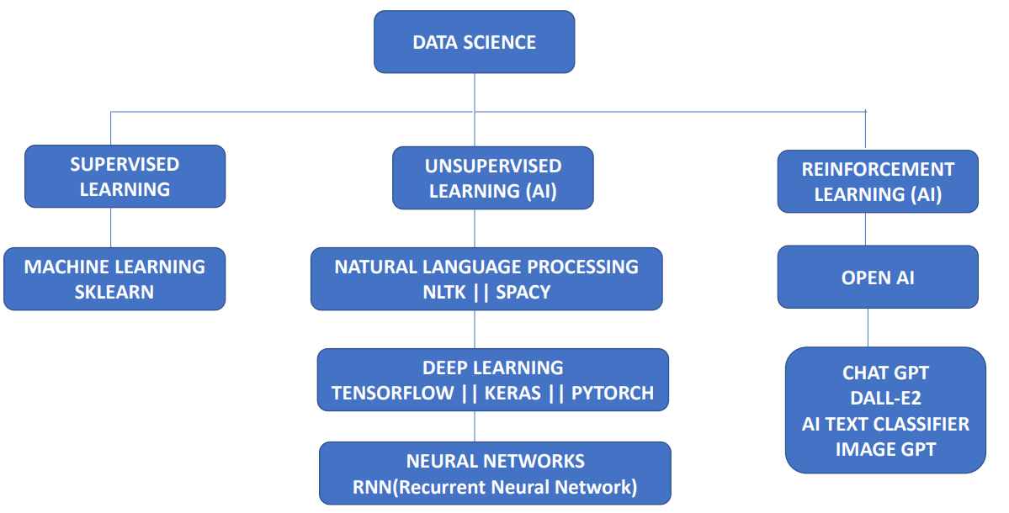

12. SUPERVISED LEARNING vs UNSUPERVISED LEARNING vs REINFORCEMENT LEARNING

Slide 21



